Slide 1




STUDENT NAME:Balaji
REGISTER NO:312200217
DEPARTMENT:B.com accounting and finance
NM ID : asunm103unm103312200217
COLLEGE S.I.V.E.T college

Slide 2







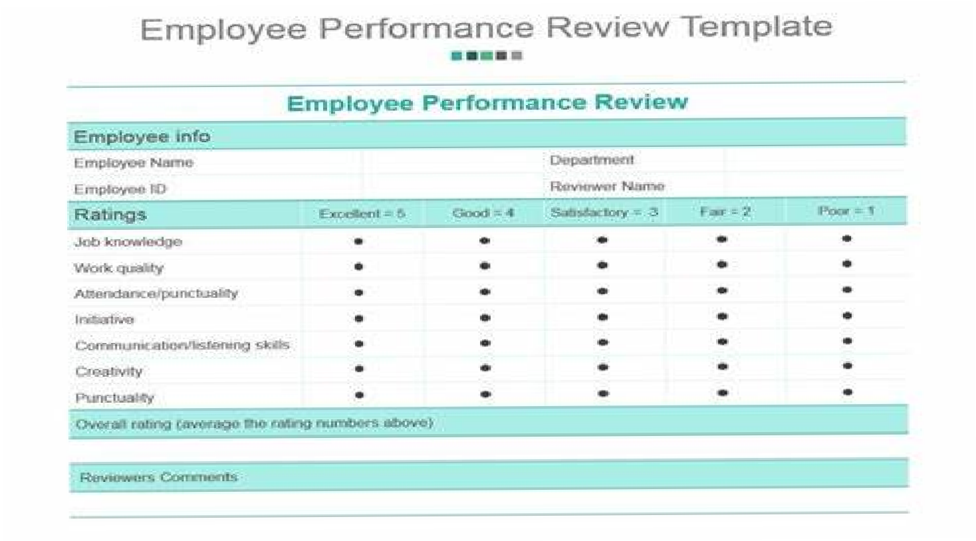

Slide 3


Problem Statement
Project Overview
End Users
Our Solution and Proposition
Dataset Description
Modelling Approach
Results and Discussion 8.Conclusion
3/21/2024

Slide 4

Difficulty evaluating performance:
This can lead to a high turnover, more turnover, more errors, and a reduced ability to manage improvement.
Skills gaps:
Organizations may not be aware of skills gaps in their employees , position of groups.
Irregular performance activities:
There may be lack ok regular performance reviews and management activities

Slide 5

•.
A perform review, also known as
employee evaluation of performance appraisal, is a formal assessment that helps identity an employee's strength and weakness, and set goals for there feature

Slide 6












Slide 7












Conditional formatting in Excel lets you highlight into or make data stand out by applying custom rules to cells
The formula is often = FILTER ( array , filter criteria, optional value)
Pivot table in Excel is a feature that help you organize and summarize data in a spread sheet

Slide 8


Employee - kaggle Features - 26 Employee id - number Name - Text Employee type Performance level
Gender - male and female Employee rating - number

Slide 9

Performance level=IFS (Z8>5, "VERY HIGH", Z8>=4, "HIGH", Z8=3,"MED",
TRUE, "LOW"
3/21/2024

Slide 10
Data collection
columns
name
role
Feature collection
sort
pivot tables
Format
Data cleaning
remove extra spaces
fill missing values

Slide 11
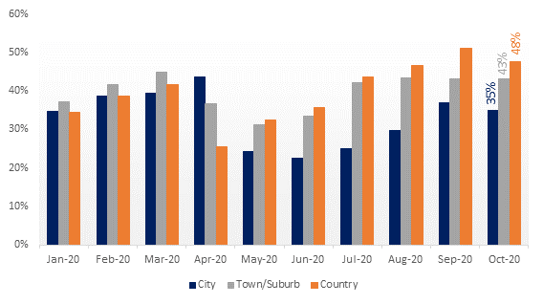

Slide 12
A conclusion of an employee performance analysis can include an summary of the employee's performance, their strengths, and areas for improvement

